Slide 1
Terraform
Monorepo vs Multiprepo
www.footasylum.com

Slide 2
Contents
What is Terraform
A history of Terraform at Footasylum
Monorepo
Multirepo
Ideas for the next steps

Slide 3
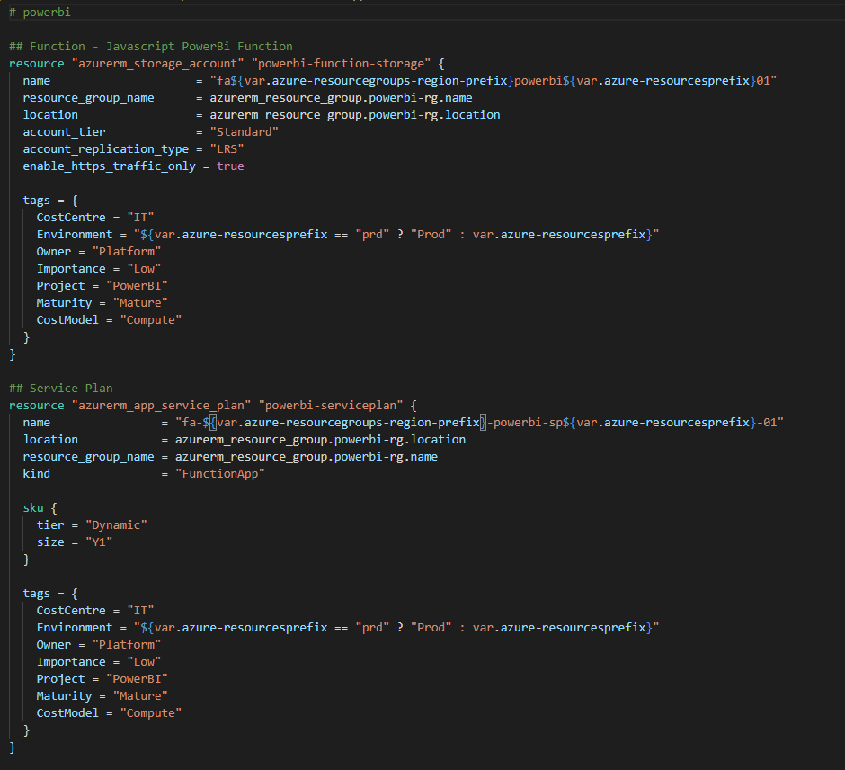

What is Terraform?
Open Source Tool for Creating and Maintaining Infrastructure
Uses Declarative Definitions written in HCL (HashiCorp Configuration Language)
Has multiple providers (Azure, AWS, Datadog etc.)

Slide 4
History of Terraform at Footasylum
Introduced by Platform team
Was a single Monorepo with small number of services
Fast become difficult to manage
Modules helped separate concerns but Platform was still a “gatekeeper”
Teams now empowered to write their own terraform files
Working towards standardizing the approach

Slide 5
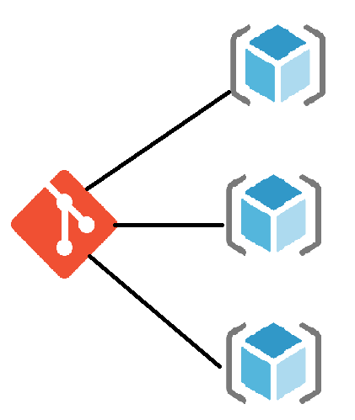
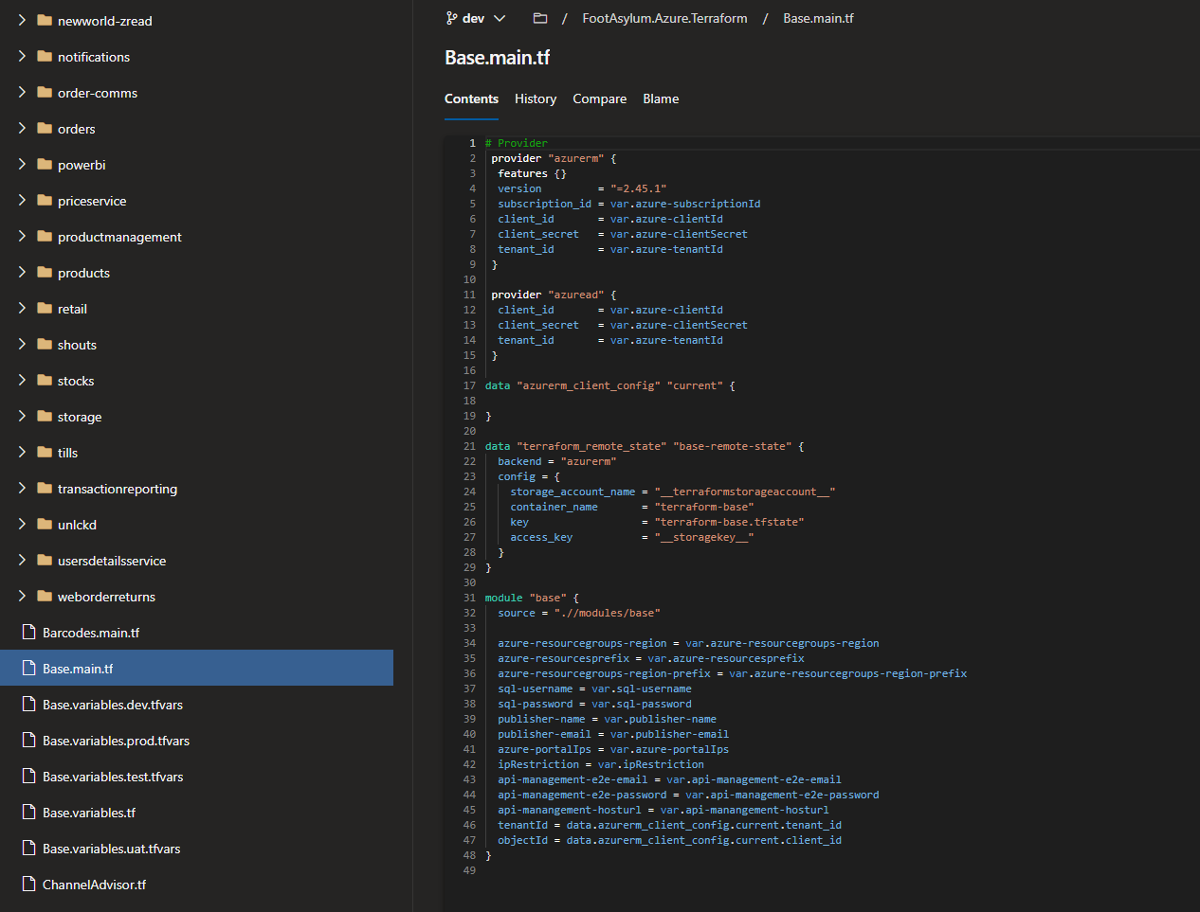
Monorepo
A Single repository with all the files needed to build the infrastructure.
PROS:
Single source of truth
Easier to assert quality control
CONS:
Can block other teams
Longer build and release lifecycle

Slide 6
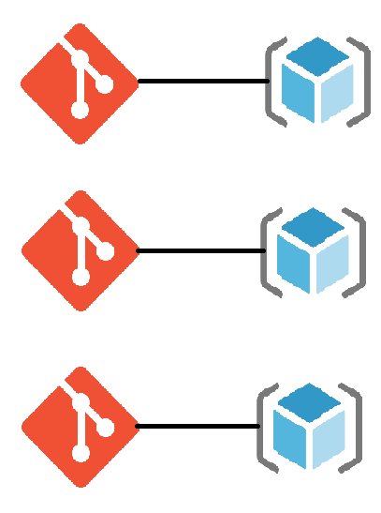
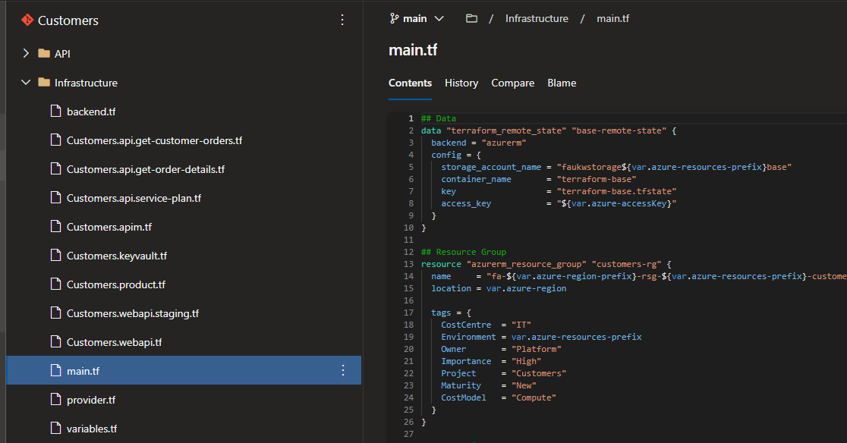
Multirepo
Multiple independent repositories containing the infrastructure just for that service / product
PROS:
Empowers/Enables teams to achieve
Removes inter-team dependencies
Faster build times
CONS:
Differences configuration / design
Harder to link dependencies between separate resources

Slide 7
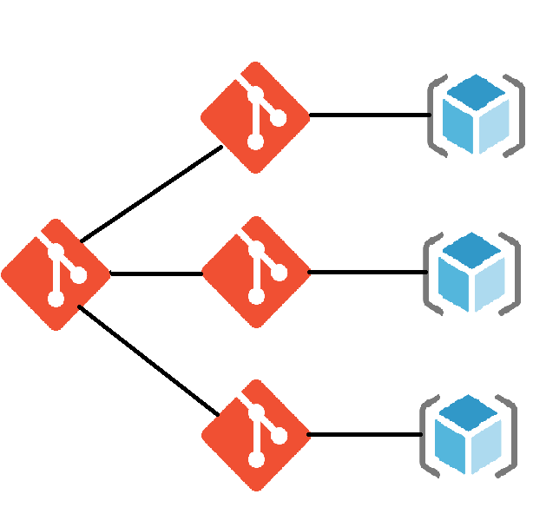
The future – A blend of the two
Mono repo for shared / consumable modules:
Like an internal Open Source library for infrastructure
Modules can be constructed with the approved set up in place
Everyone can benefit from and contribute to the “baseline”
Multi repo for teams:
Empowers them to take ownership of their infrastructure
Standardised modules removes cognitive load from the resources
Improves or better aligns the over all infrastructure

